Slide 1
DS 207– Applied Machine Learning
Cornelia Paulik, PhD
School of Information
UC Berkeley
Hyperparameter Tuning in ML

Slide 2

Learning objectives
Hyperparameter tuning definition
Tuning techniques
Monitor learning curves
Debugging learning curves

Slide 3

Definition
Hyperparameter tuning is the process of optimizing the hyperparameters of a ML model to improve its performance.
Hyperparameter examples include:
- learning rate
- # of epochs
- batch size
- # of layers and units
- optimizer
Not the same thing as model parameters, which are learned during training (e.g., weights)

Slide 4
Tuning techniques
Manual search: trial-and-error approach; you manually adjust hyperparameters based on experience and intuition
Grid search: exhaustive search over a specified parameter space (can be computationally expensive)
Random search: random sampling and evaluation of hyperparameter combinations (more efficient than grid search if the param space is large)
Hyperband tuning: A novel bandit-based approach to hyperparameter optimization (very useful for deep learning)
Others…

Slide 5
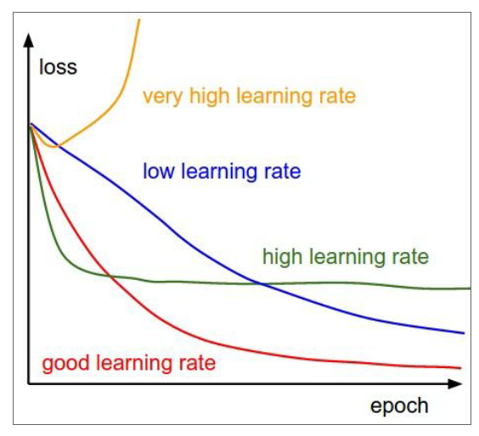
e.g., Best learning rate?
They are all good! They give you a hint on how to improve your model performance by adjusting the hyperparameter value.

Slide 6
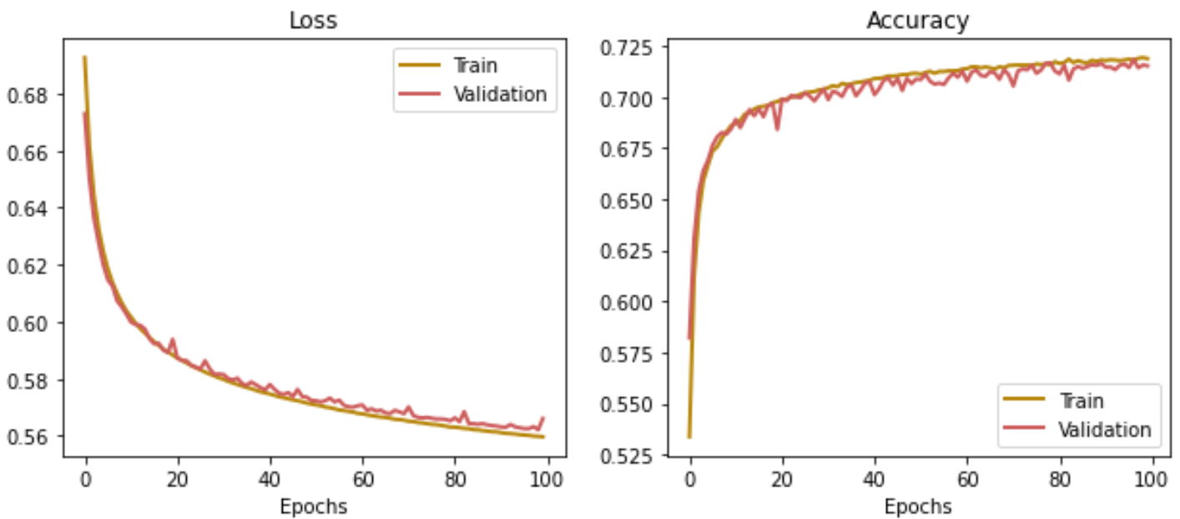
Monitor learning curves
Monitor training and validation metric
Monitor training and validation loss

Slide 7



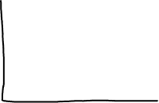

Debugging learning curves
Overfitting
Underfitting
Training loss may continue to decrease but validation may get worse -> fix: stop training earlier
High loss, the model is not learning sufficiently. Small or no gap between training and validation loss -> fix: increase learning rate, reinitialize weights

Slide 8
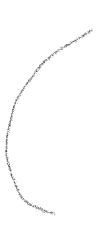

Debugging learning curves
So what is about right?
Best models overfit slightly (i.e., you want a little bit of gap between training and validation loss)
Why you want a gap: can improve generalization performance
Very nice elbow shape: notice the steep improvement at the beginning

Slide 9


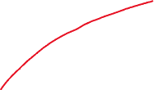
Debugging learning curves
What if your performance on validation is better?

Slide 10
Debugging learning curves
What If your performance on validation is better?
Your training data is likely underfitting. Even though this happens, your validation data may perform well under the situation.
Maybe your validation examples are different/easier to predict? Shuffle the data multiple times and average the prediction results.

Slide 11





Debugging learning curves
Plateau might indicate bad initial weights?
Loss decreases slowly. Try higher learning rate?
Healthy loss curve plateaus, try learning rate decay at plateau point
Metric still improving, keep training!

Slide 12

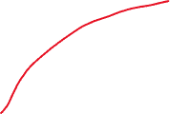

Debugging learning curves
Stop training here
Early stopping:
stop training when the performance gap between training and validation increases!

Slide 13
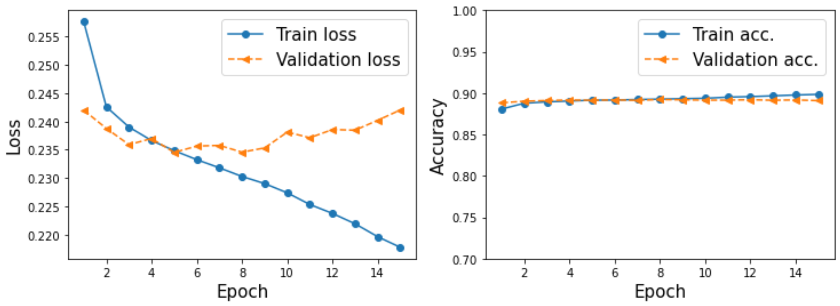
Debugging learning curves
What do you recommend?

Slide 14
Debugging learning curves
What do you recommend?

